Slide 1
The White House
Atik Shahriar Ratul
ID : 011131178

Slide 2
Features of the project
1.view of the whitehouse
2.moving all side
3.view front side

Slide 3
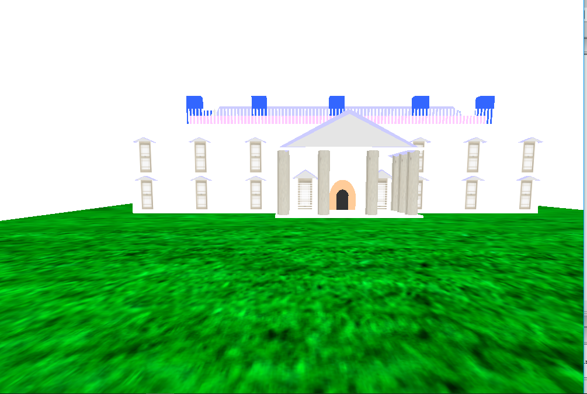
Project screenshot

Slide 4
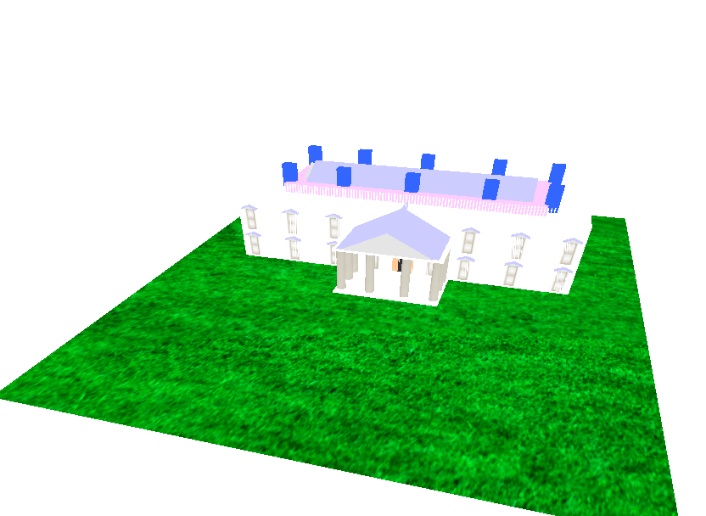
Project screenshot

Slide 5
Thank you

